Slide 1
Week 5 – Sprint Retrospective, Quality, definition of done
Michael Dempewolf
November 17, 2016

Slide 2

Agenda
Exam (30 minutes)
Review (5 minutes)
Sprint Retrospective (20 minutes)
Quality (15 minutes)
New Project! (10 minutes)
Sprint 4 Planning (30 minutes)

Slide 3

Review
What is a daily scrum?
What is change?
How do we manage change?

Slide 4
Sprint Retrospective
Periodically take a look at what is and is not working
Typically 15–30 minutes
Done after every sprint
Whole team participates
Scrum Master
Product owner
Team
Possibly customers and others

Slide 5

Sprint Retrospective (Cont.)
Whole team gathers to discuss what they would like to:
Start doing
Stop doing
Continue doing

Slide 6
Quality
What did you learn from your research?
What should we test?
Who does the testing?
How do you ensure you do not break something from a previous sprint?
Stabilization Sprint / Hardening Sprint / SRT / Release Testing

Slide 7
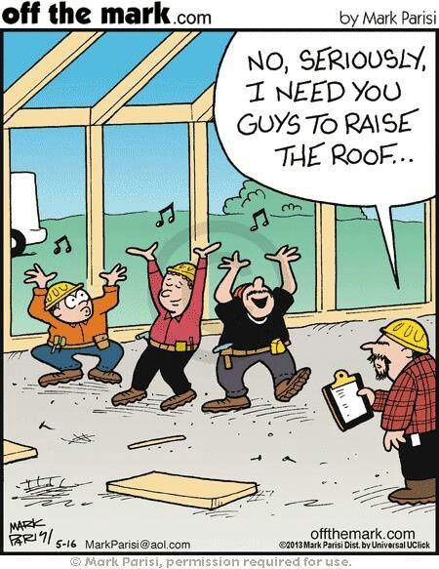

Quality (Cont)
What is the definition of done?

Slide 8
Quality (cont.)
How do we know when we are done?
How do we test it?
What sort of tests?
What should we automate?
What should we test manually?
When should we test?

Slide 9
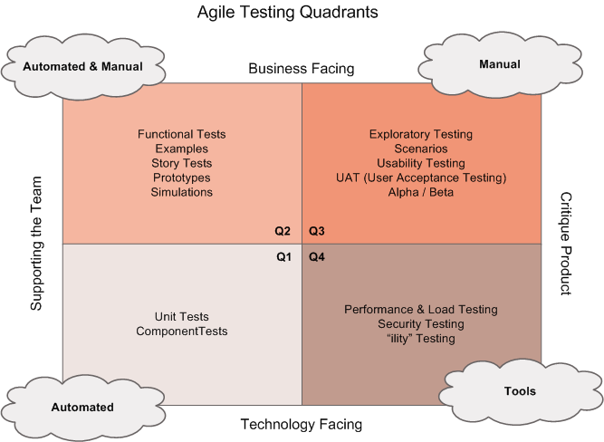
Quality (Cont.)

Slide 10
New Project
The CEO is happy with the success the team is having with Scrum
New project which will allow cities to manage assets
Wants to release by mid May
Time to create a backlog and add some estimates
Don’t forget the prioritization and cut off line

Slide 11
Change
The CIO of the company is happy with the success of Scrum. In fact she is so happy she wants to use it for all of the teams. Great!
In order to provide consistency, all teams are required to use the same format and tools
All Teams must use ClarkeSoft Tools

Slide 12
Sprint 4 Planning
Break into your teams
Conduct Sprint 4 planning

Slide 13

Questions

Slide 14
References:
Question mark = http://www.agile-code.com/blog/easy-task-estimation-with-three-point-estimation-technique/
Testing Quadrants = http://lisacrispin.com/2011/11/08/using-the-agile-testing-quadrants/

Slide 15
Questions for you
What do you do if a team member continues to fail to meet his/her tasks?
What do you do if a team member works on something they feel is important but was not in the sprint?
What if it is supposed to be in the sprint and it is not?
Can we add anything to the sprint after sprint planning and commitment?

